Slide 1

ORDERING CGM
on Parachute Health!

Slide 2

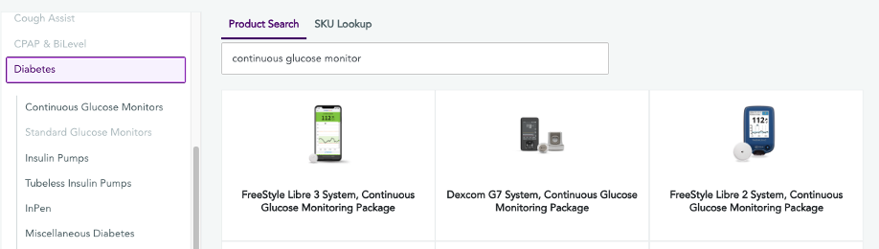
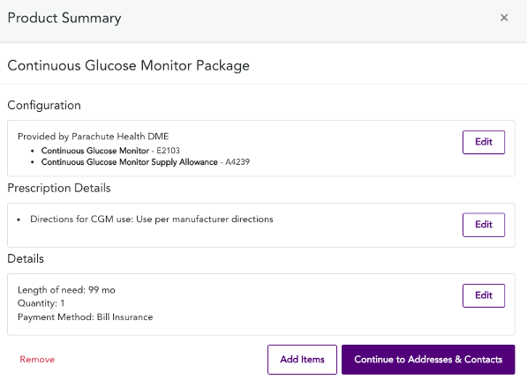

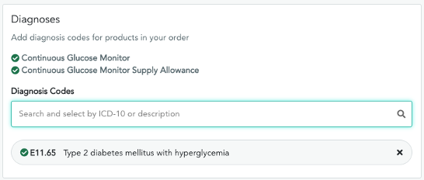


Diabetes - Continuous Glucose Monitor for Referrals
1
Select Your Product
1
Select Your Product
After entering the patient's name, date of birth, gender, and insurance info, you can start shopping! Either search for "Continuous Glucose Monitor Package" or select the Diabetes category.
After entering the patient's name, date of birth, gender, and insurance info - you can start shopping! Either search for "Continuous Glucose Monitor Package" or select the Diabetes category.
Up to 85% Faster
Time from Order to Delivery by ePrescribing on the Parachute Platform
2
Review Product Summary
After entering the patient's name, date of birth, gender, and insurance info, you can start shopping! Either search for "Continuous Glucose Monitor Package" or select the Diabetes category.
3
Enter Diagnosis Code(s)
After entering the patient's addresses and contacts, go to the Clinical Info Page to select the patient's diagnosis and we will tell you if it qualifies.
‹#›

Slide 3
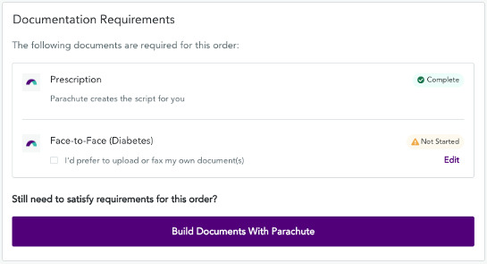
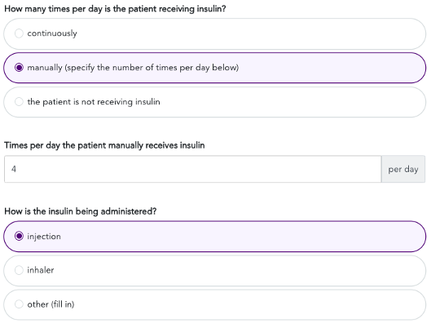
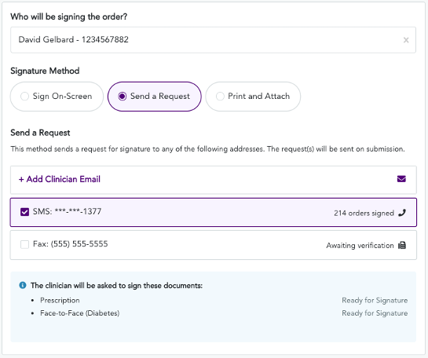

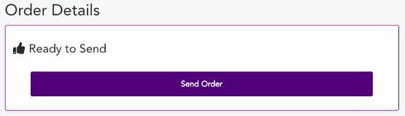
Diabetes - Continuous Glucose Monitor for Referrals
4
Review Document Requirements
From the Clinical Info page, you can also check which documents are required to fulfill the order, if they can be generated in Parachute or if they'll need to be attached.
5
Complete Survey
Answer each question and add any notes at the end, if desired, then
press Continue.
6
Select the Signature Method
Sign On-Screen: If the clinician is there to press the 'Sign' button.
Send a Request via SMS: Allows the clinician to sign on their phone (most effective). You can add a clinician's cell phone number or email if it is not already entered.
7
Send Order
Review the order and press Send Order and you're done!
‹#›

